Slide 1
(MACHINE) LEARNING
Supervised Learning, Regression and Classification with Linear models, neural networks, support vector machines, ensemble learning

Slide 2
Plan
Learning from Examples
Supervised learning
Linear regression
Cost function
Logistic regression
Binomial classification
Cost function

Slide 3
Learning from Examples
Machine learning is defined as the field of study that gives computers the ability to learn without being explicitly programmed.
Learning involves acquiring knowledge or skills from experience or data.
The 3 main forms of learning include supervised, unsupervised, reinforcement learning.

Slide 4
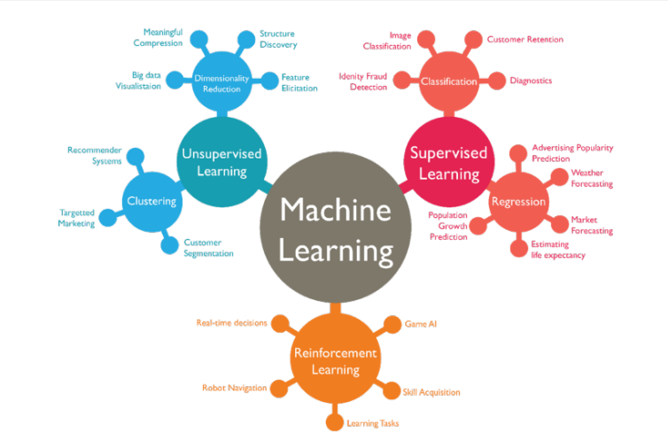

Slide 5
Supervised Learning
In supervised learning, we are given a data set and already know what out correct output should look like.
We use a set of variables (or features), denoted as X, to predict an outcome, Y.
Supervised learning problems are classified into “regression” and “classification” problems

Slide 6
Supervised Learning
In a regression problem, we are trying to predict results within a continuous output.
Example: predicting the price of a house given its dimension. The price has a continuous range of values.
In a classification problem, we are instead trying to predict results in a discrete output.
Example: predicting the type of breast cancer (malignant or benign) given the tumor size

Slide 7
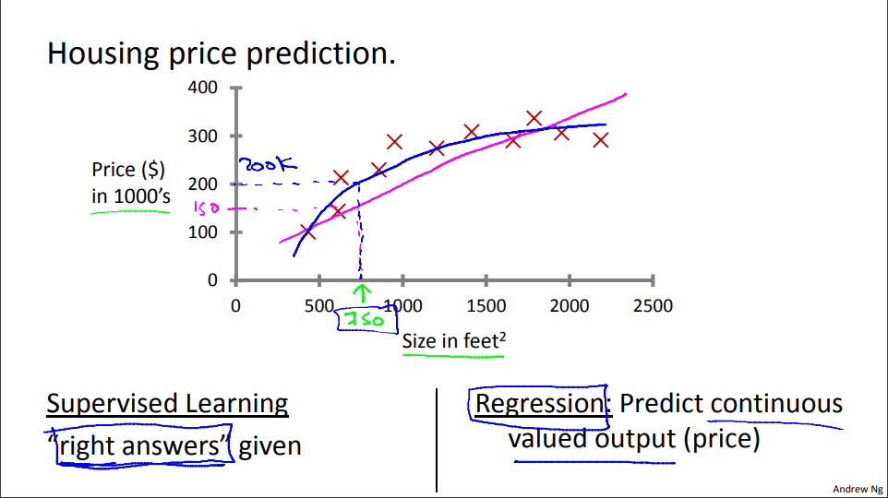

Slide 8
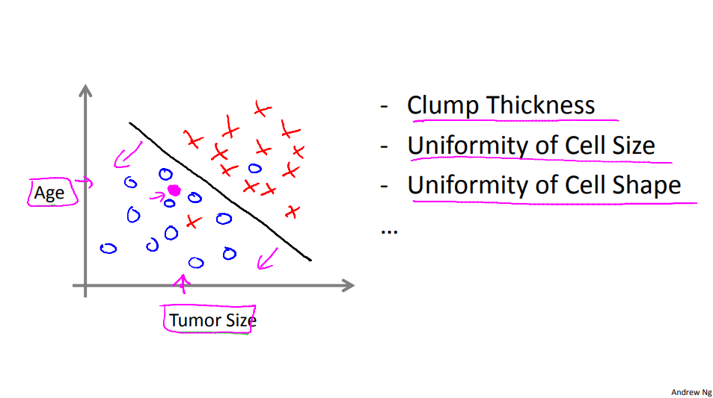

Slide 9
Supervised learning – Refresher
You’re running a company, and you want to develop learning algorithms to address each of two problems.
Problem 1: You have a large inventory of identical items. You want to predict how many of these items will sell over the next 3 months.
Problem 2: You’d like software to examine individual customer accounts, and for each account decide if it has been hacked/compromised.
Should you treat these as classification or as regression problems?

Slide 10
Supervised learning – Linear Regression
The goal of linear regression is to “fit” a linear equation to a data set.
Fitting the linear equation is finding the parameters of a linear equation that best models the relationship between the features and the outputs.

Slide 11
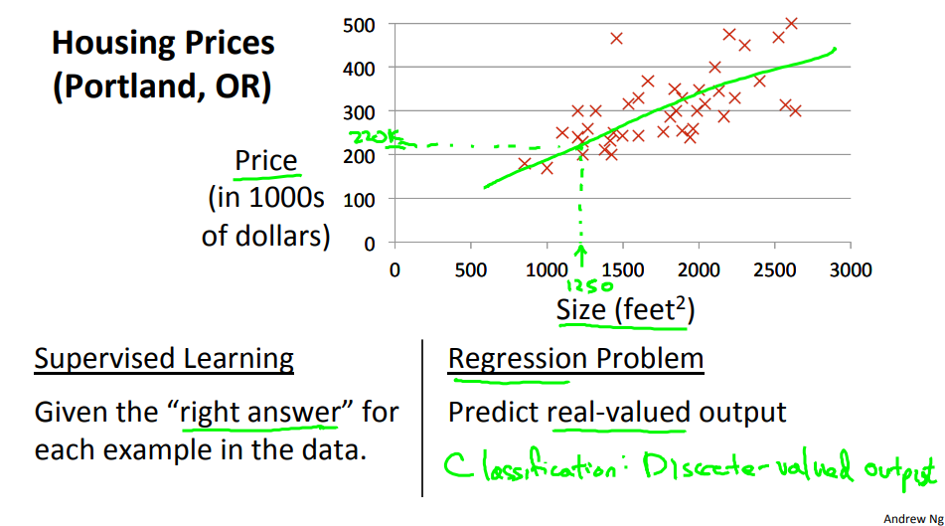
Supervised learning – Linear Regression

Slide 12
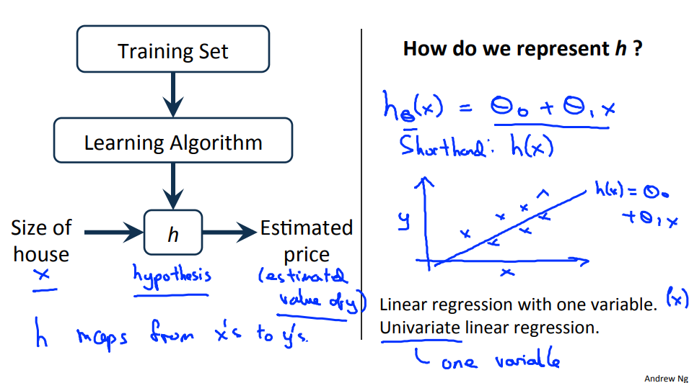
Supervised learning – Linear Regression

Slide 13

Supervised learning – Linear Regression – Cost function
The parameters of a linear equation are y = mx + b.
For the rest of this presentation, we are going to be using the notation
The cost function is used to measure the accuracy of our hypothesis function. It takes an average difference of all the results of the hypothesis with inputs from x’s and the actual output y’s.

Slide 14
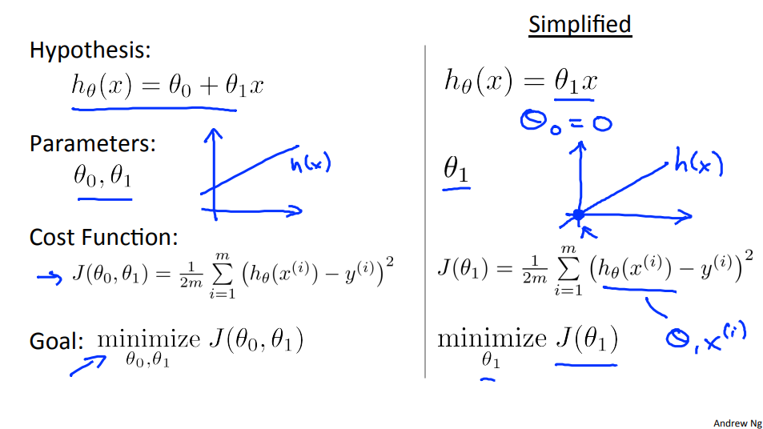
Supervised learning – Linear Regression – Cost function

Slide 15
Supervised learning – Linear Regression – Cost function
Let’s consider a data set of 3 items (1, 1), (2, 2), (3, 3) and a hypothesis function
Calculate the cost for the following scenarios
Θ0 = 1.5, θ1 = 0
Θ0 = 0, θ1 = 0.5
Θ0 = 1, θ1 = 0.5

Slide 16
Supervised learning – Logistic Regression – Binomial Classification
Logistic regression is used for classification problems.
It provides a hypothesis function (the sigmoid or logistic function) that outputs values between 0 and 1.
The hypothesis output is the estimated probability that y is equal to 1 for a given input

Slide 17
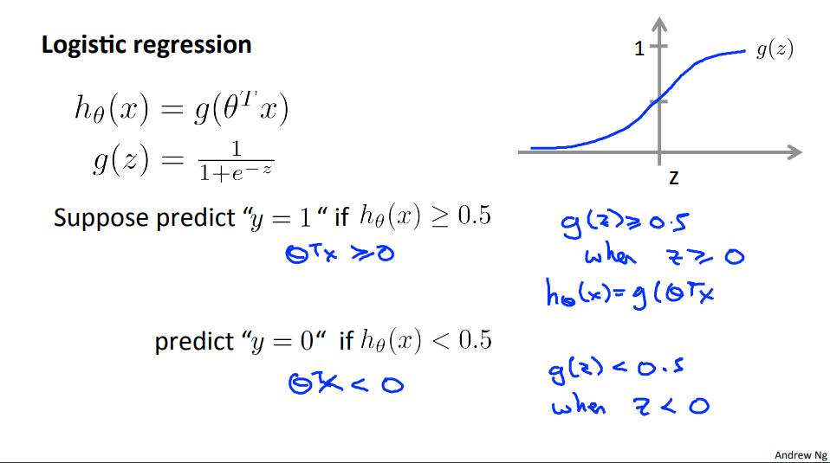

Slide 18
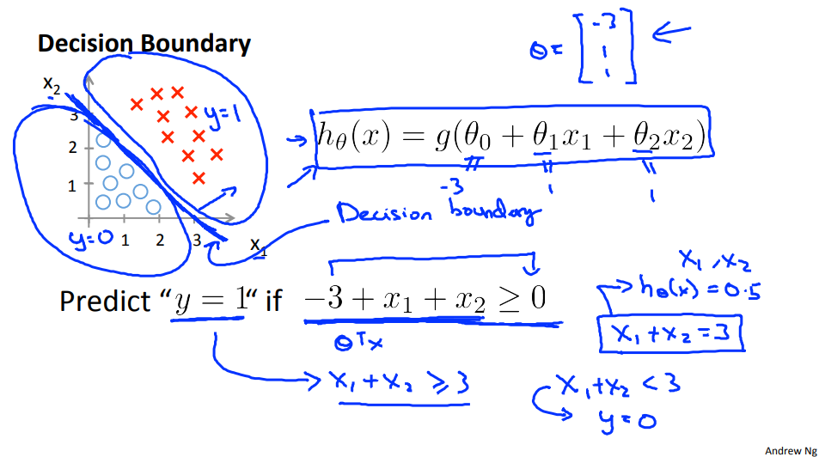

Slide 19
Supervised learning – Optimization algorithms – Gradient Descent
When fitting a model to our data, we need to be able to update our parameters in a way that reduces the cost of our model.
One of the most popular optimization algorithms is Gradient Descent.
Gradient Descent allows us to converge on a local minimum/maximum (i.e. a set of parameters that gives us the least possible cost)

Slide 20
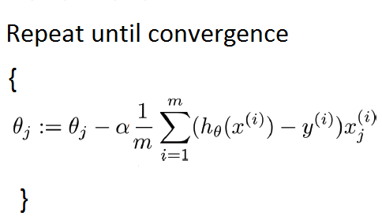
Supervised learning – Optimization algorithms – Gradient Descent
Where
Θ_{j} is a parameter j
α is the learning rate
m is the number of samples in the dataset
x^{(i)} and y^{(i)} are the i^{th} attributes and target respectively
h_{θ}(x^{(i)}) is the prediction of the ith attributes
x^{(i)}_{j} is the j^{th} attribute of the i^{th} sample.

Slide 21
Supervised learning – Optimization algorithms – Gradient Descent

Slide 22
Supervised learning – Optimization algorithms – Advanced optimization
Conjugate gradient
BFGS (Broyden–Fletcher–Goldfarb–Shanno) algorithm
L-BFGS (Limited-memory BFGS)

Slide 23
Recap
Learning from examples
Supervised Learning
Linear Regression
Logistic Regression
Cost function and Optimization algorithms

